Slide 1
Pre-Live Session
ARIMA and ARUMA Models

Slide 2
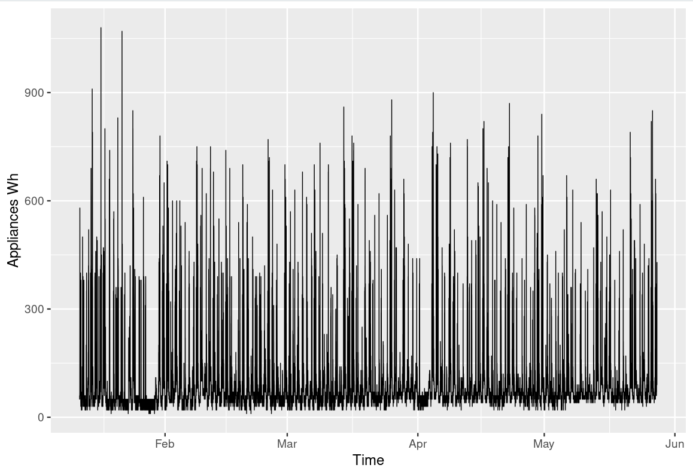
House Appliance in Wh

Slide 3
House Appliances energy Data Set
Looking at your time series from the first day of class, you addressed its stationarity before. Does either a signal plus noise, ARIMA, or ARUMA (seasonal) model seem appropriate?
The plot looks like it’s none stationary because it could be seasonal. So in that case ARUMA model would be most appropriate.

Slide 4
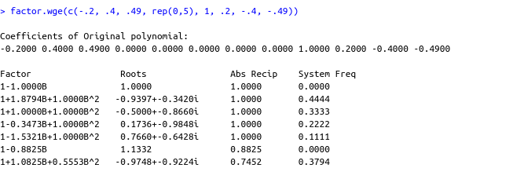
Copy and paste the factor table for a seasonal model with s = 7.
Am not quite sure how to do this.

Slide 5
(1+.3B) X_{t} = (1−.6B+.8B²) a_{τ}
This is is ARMA(p,q)
(1−B⁴) X_{t} = (1+.3B) (1−.6B+.8B²)a_{τ}
This is ARUMA model 003
(1−.1B-.99B² +.013B³ +.2078B⁴ +.0888B⁵ +.00864B⁶)(1−B)²(1−B¹²) X_{t} = (1−.6B+.8B²)a_{τ}
This is ARUMA model p = 6, d = 2, s =12, q = 2
ARUMA(6,2,2)

Slide 6
Takeaways
If we subtract out signal, the residuals which is noise maybe stationary and if stationary may be model as AR, MA or ARMA.
ARIMA model is a process X_t whose difference (1-B)X_t satifys a stationary ARMA model.
For ARIMA models, phi_1 = 1, the variance of X_T is infinite and thus the autocorrelation are undefined.
The (1-B)^d factor dominates the stationary components in the realizations, autocorrelations, and all spectral densities have peaks at frequency of 0
As d increases the dominance of the actor increases.
Slowly damping sample autocorrelations is an indication of ARIMA data.

